Slide 1

Euler "𝑒" Slopes? => page 5
$f(x)=ex$

Slide 2

Euler "𝑒" Slopes?
$f(x)=ex$ x
$\frac{d}{dx}ex=ex$

Slide 3

Euler "𝑒" Slopes?
$f(x)=ex$ x
$\frac{d}{dx}ex=ex$ $\text{→ }\text{derivative}\text{ (}\text{slope}\text{) }\text{equals} ex \text{→ }\text{unique}$

Slide 4

Euler "𝑒" Slopes?
$f(x)=ex$ x
$\frac{d}{dx}ex=ex$ $\text{→ }\text{derivative}\text{ (}\text{slope}\text{) }\text{equals} ex \text{→ }\text{unique}$
$x=0$

Slide 5

Euler "𝑒" Slopes?
$f(x)=ex \text{→ }\text{derivative}\text{ (}\text{slope}\text{) }\text{equals} ex \text{→ }\text{unique}$x
$\frac{d}{dx}ex=ex$ $\text{→ }\text{derivative}\text{ (}\text{slope}\text{) }\text{equals} ex \text{→ }\text{unique}$
$x=0$
$f\left(0\right)=e0$ $=1$
Slope = 1

Slide 6

Euler "𝑒" Slopes?
$f(x)=ex \text{→ }\text{derivative}\text{ (}\text{slope}\text{) }\text{equals} ex \text{→ }\text{unique}$x
$\frac{d}{dx}ex=ex$ $\text{→ }\text{derivative}\text{ (}\text{slope}\text{) }\text{equals} ex \text{→ }\text{unique}$
$x=0$
$f\left(0\right)=e0$ $=1$
Slope = 1
$x=0\text{.5}$

Slide 7

Euler "𝑒" Slopes?
$f(x)=ex \text{→ }\text{derivative}\text{ (}\text{slope}\text{) }\text{equals} ex \text{→ }\text{unique}$x
$\frac{d}{dx}ex=ex$ $\text{→ }\text{derivative}\text{ (}\text{slope}\text{) }\text{equals} ex \text{→ }\text{unique}$
$x=0$
$f\left(0\right)=e0$ $=1$
Slope = 1
$x=0\text{.5}$
$f\left(0.5\right)=e0.5$ $≈1.64872$
Slope $≈1.64872$

Slide 8
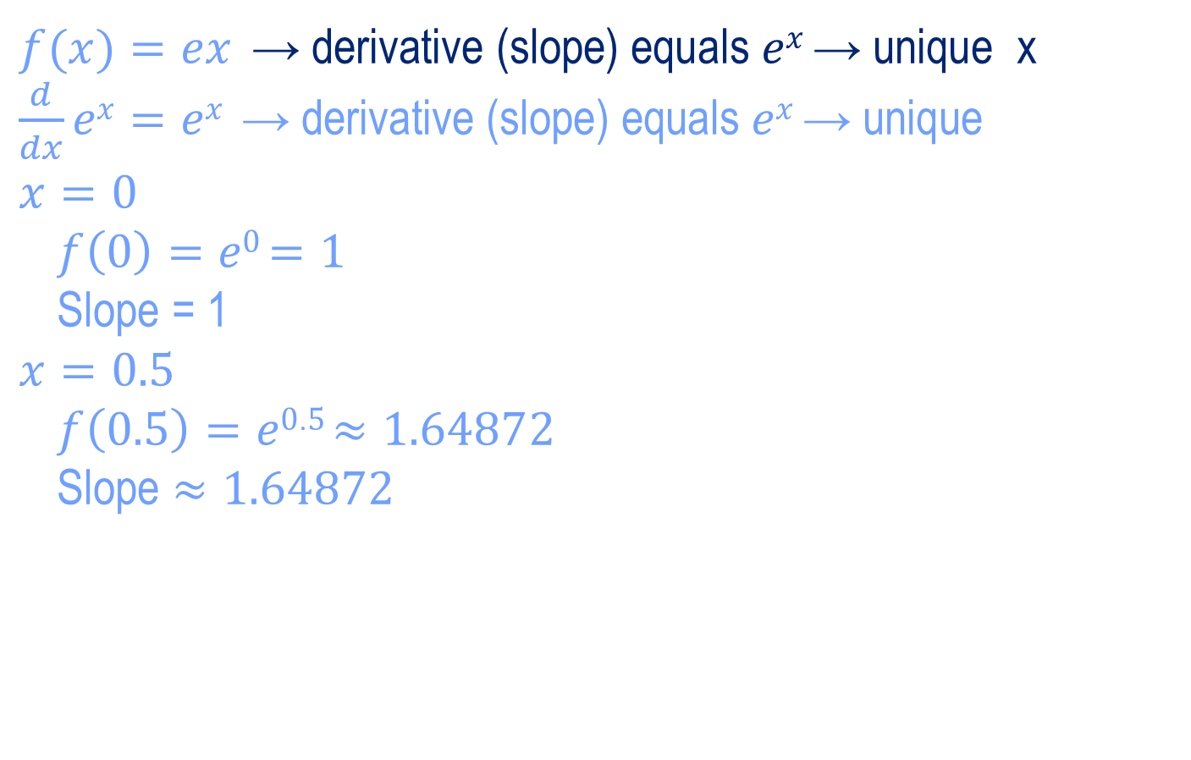
Euler "𝑒" Slopes?
$f(x)=ex \text{→ }\text{derivative}\text{ (}\text{slope}\text{) }\text{equals} ex \text{→ }\text{unique}$x
$\frac{d}{dx}ex=ex$ $\text{→ }\text{derivative}\text{ (}\text{slope}\text{) }\text{equals} ex \text{→ }\text{unique}$
$x=0$
$f\left(0\right)=e0$ $=1$
Slope = 1
$x=0\text{.5}$
$f\left(0.5\right)=e0.5$ $≈1.64872$
Slope $≈1.64872$
$x=\text{1}$

Slide 9
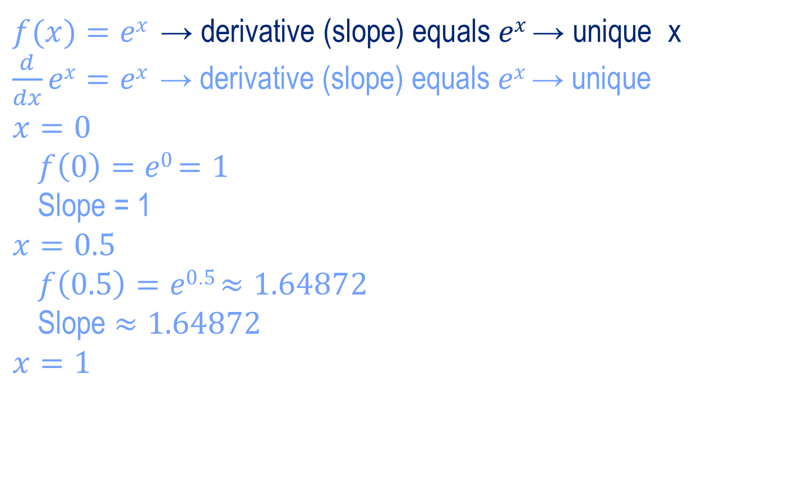
Euler "𝑒" Slopes?
$f(x)=ex \text{→ }\text{derivative}\text{ (}\text{slope}\text{) }\text{equals} ex \text{→ }\text{unique}$x
$\frac{d}{dx}ex=ex$ $\text{→ }\text{derivative}\text{ (}\text{slope}\text{) }\text{equals} ex \text{→ }\text{unique}$
$x=0$
$f\left(0\right)=e0$ $=1$
Slope = 1
$x=0\text{.5}$
$f\left(0.5\right)=e0.5$ $≈1.64872$
Slope $≈1.64872$
$x=\text{1}$
$f\left(1\right)=e1$ $≈2.71828$
Slope $≈2.71828$

Slide 10
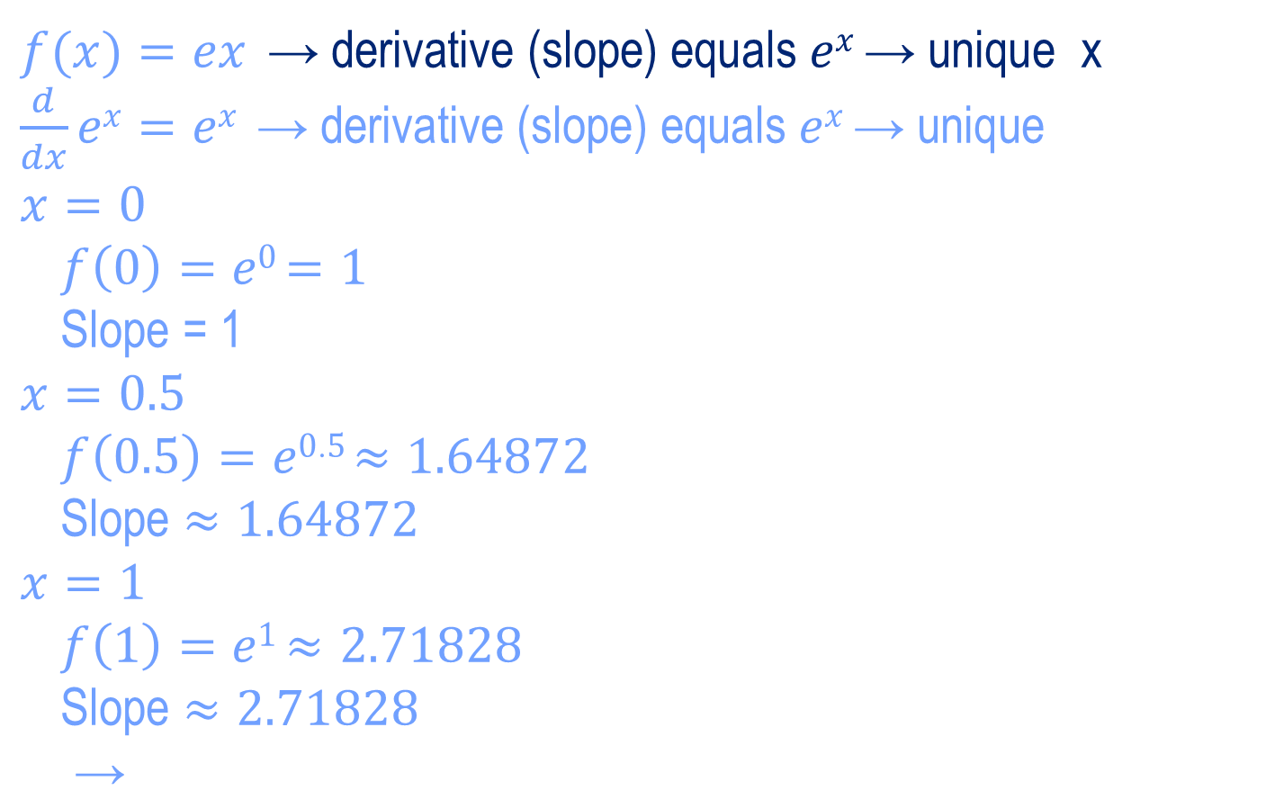
Euler "𝑒" Slopes?
$f(x)=ex \text{→ }\text{derivative}\text{ (}\text{slope}\text{) }\text{equals} ex \text{→ }\text{unique}$x
$\frac{d}{dx}ex=ex$ $\text{→ }\text{derivative}\text{ (}\text{slope}\text{) }\text{equals} ex \text{→ }\text{unique}$
$x=0$
$f\left(0\right)=e0$ $=1$
Slope = 1
$x=0\text{.5}$
$f\left(0.5\right)=e0.5$ $≈1.64872$
Slope $≈1.64872$
$x=\text{1}$
$f\left(1\right)=e1$ $≈2.71828$
Slope $≈2.71828$
$ex \text{→ }\text{unique}$

